Slide 1
Document Loader

Slide 2
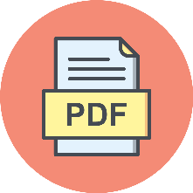

Document
Loader
Text
Splitter
Text chunks
PDF
Loaded PDF
embedding model
Embeddings
Vector Database
embedding model
Retriever
+
Final output
user query
Embeddings
Semantic search
Result chunks + user query
LLM

Slide 3
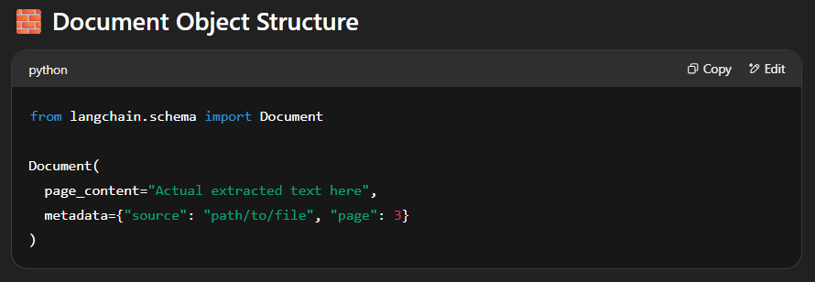
In LangChain, a Document Loader is the component that helps you load raw data (text, PDFs, websites, etc.) into LangChain as documents.

Slide 4
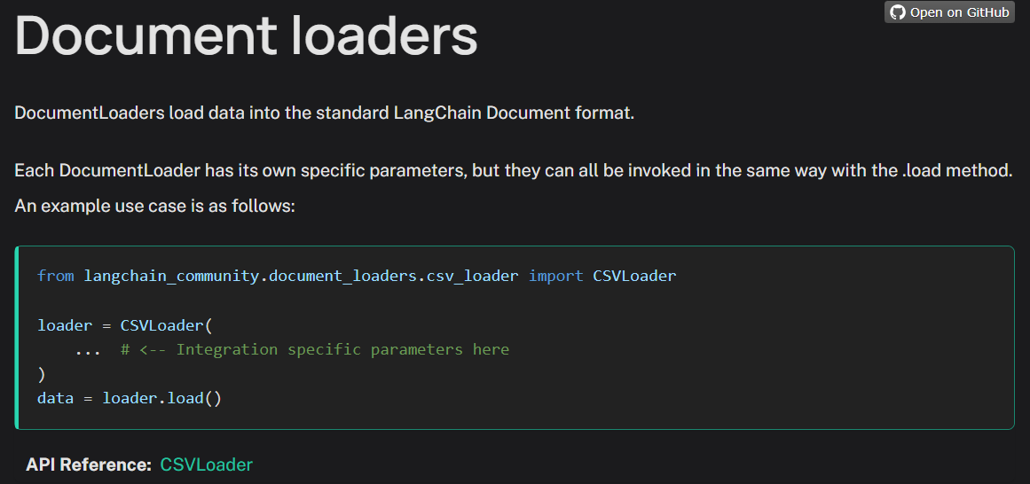
Document loaders:
https://python.langchain.com/docs/integrations/document_loaders/
Text Loader
PyPDFLoader
Directory Loader
CSVLoader
WebBaseLoader

Slide 5
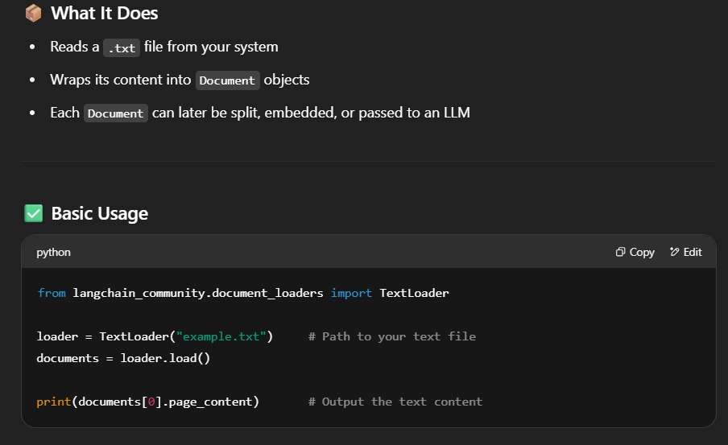
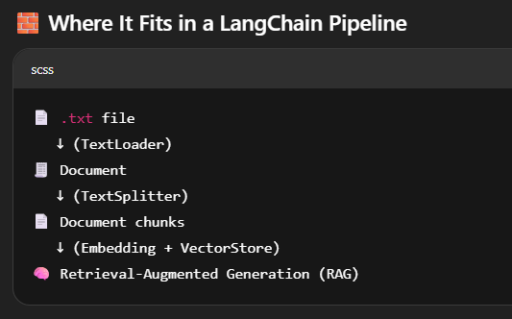
In LangChain, a TextLoader is a document loader used to load plain text files (.txt) and convert them into a format that LangChain can work with — specifically, into a list of Document objects.
https://python.langchain.com/docs/integrations/document_loaders/pypdfloader/

Slide 6
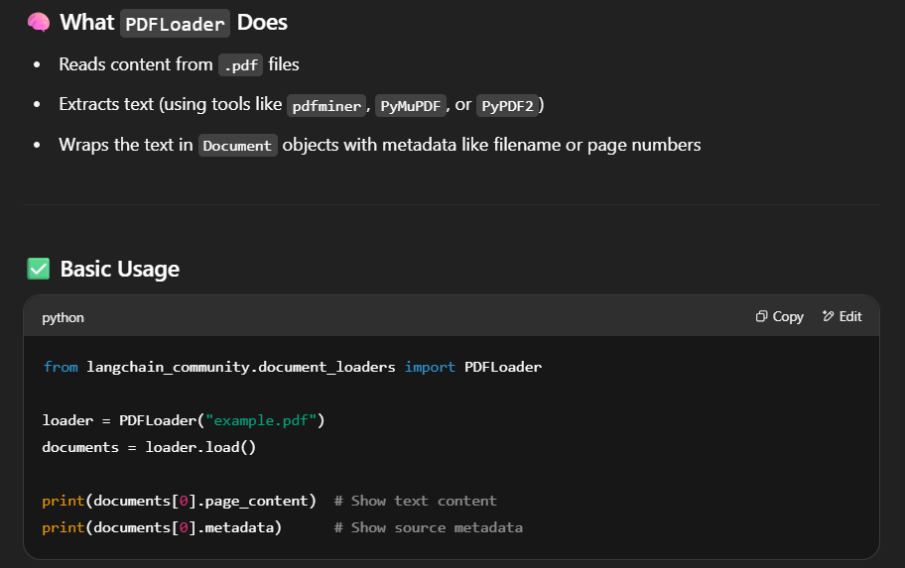
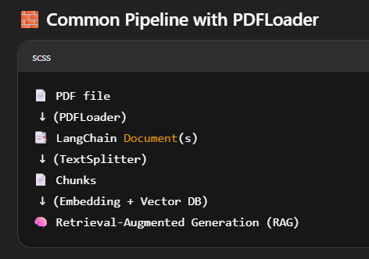
In LangChain, the PDFLoader is a document loader used to read and extract text from PDF files and convert them into Document objects for use in language model pipelines — like chunking, embedding, or RAG (Retrieval-Augmented Generation).
https://python.langchain.com/docs/how_to/document_loader_directory/

Slide 7
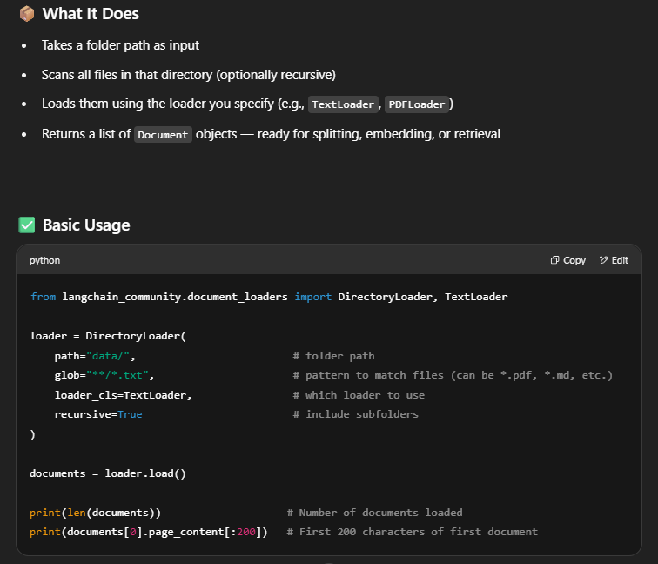
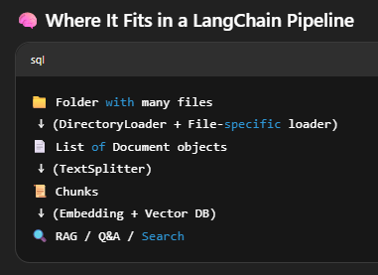
In LangChain, the DirectoryLoader is a utility that loads multiple files from a folder, to each file based on its extension.
https://python.langchain.com/docs/how_to/document_loader_directory/

Slide 8
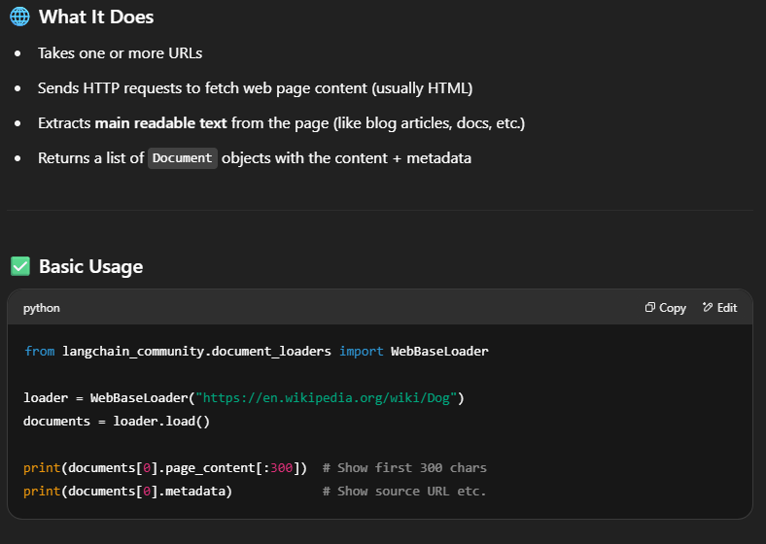
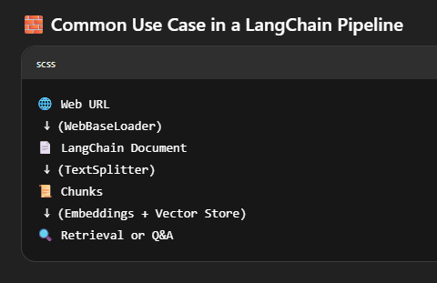
In LangChain, a WebBaseLoader is a document loader that fetches and loads content directly from webpages (URLs) into Document objects.
https://python.langchain.com/docs/integrations/document_loaders/web_base/

Slide 9
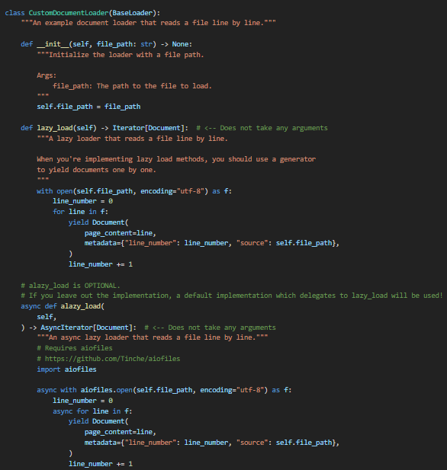
Custom document loader
https://python.langchain.com/docs/how_to/document_loader_custom/#overview

Slide 10
THANK YOU FOR YOUR TIME

